Slide 1

Team Cherps
Bang | Sean
Mentor: Cher Han

Slide 2
Content
Product Vision
Interview Process
Problem Statement
Personas
Solution Overview

Slide 3
Product Vision
A world where educators can engage students with ease,
where teachers and students are enjoying classes and don’t want the lesson to end.
Notes:
What is an imagined future like?
Vision is like a world where educators can engage the students with ease, where teachers and students are enjoying learning and don’t want the lesson to end
Vision = What do you imagine the future to be? Future scenario = Excite + Inspire you
Mission = How you get there. WHat is it you’re building to achieve it?

Slide 4
Product Mission
How can we create tools to
enable students to learn better?
empower educators to teach better
Notes:
What is an imagined future like?
Vision is like a world where educators can engage the students with ease, where teachers and students are enjoying learning and don’t want the lesson to end

Slide 5
Teachers
Tutors
Parents
Students

Slide 6
Professors
Super tutors
Teachers
Tutors
“Student” tutors
Secondary
Tertiary
Parents
Students
Busy
Stay at home
University
Primary

Slide 7
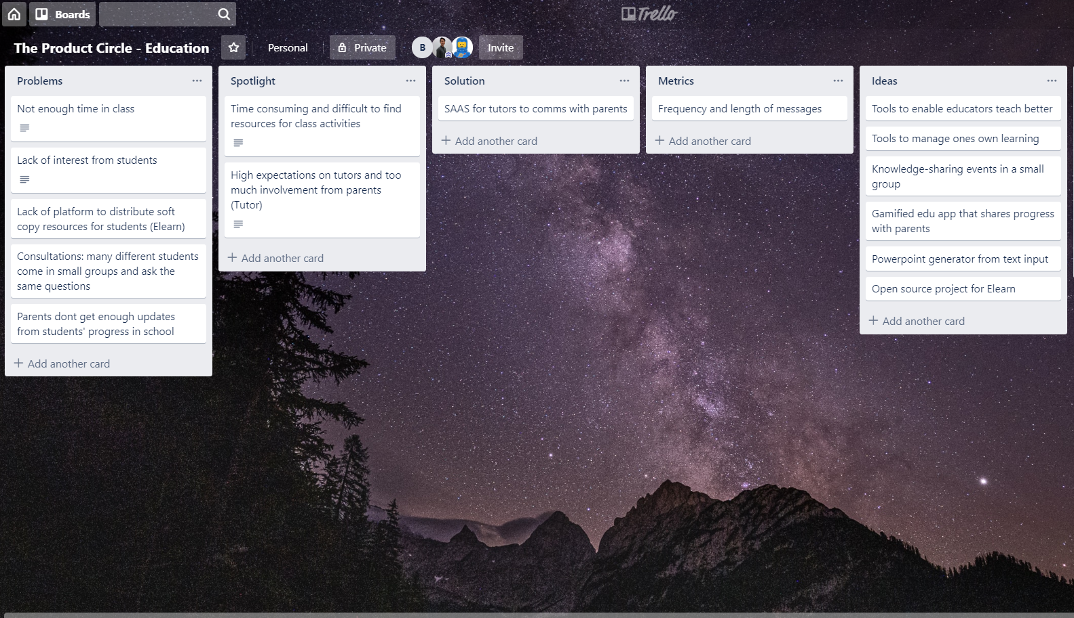

Slide 8
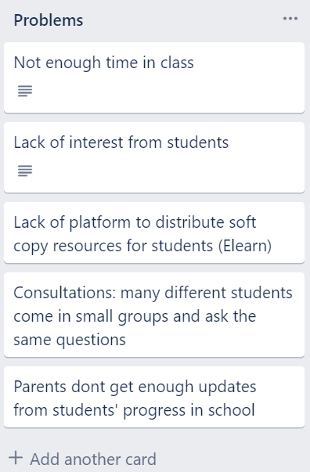
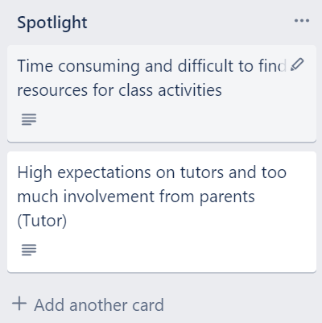

Slide 9
TUTORS

Slide 10



Interview Process
Goal
Attitude
Frustration

Slide 11

Ask the right questions
How does your teaching session typically look like?
What do you look forward most in every lesson?
What are the problems you currently face?

Slide 12
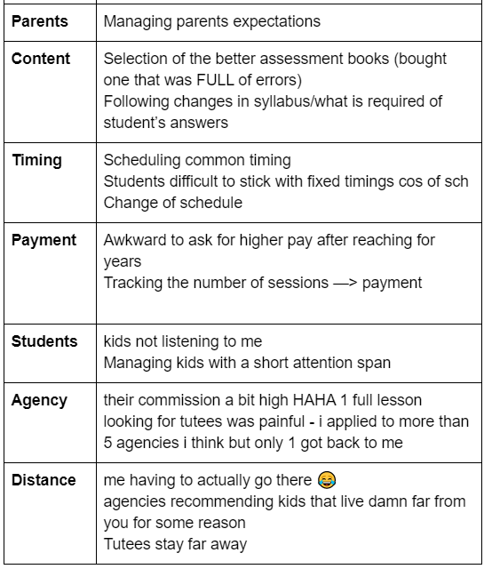
Categorize the problem

Slide 13
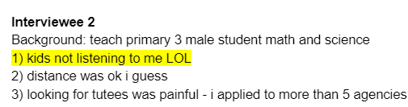
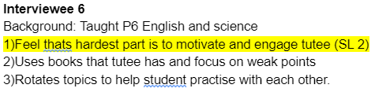
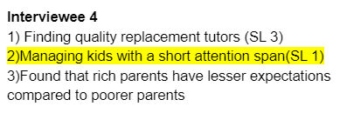
Select the problem

Slide 14
Problem Statement
Educators find it difficult to keep young students engaged and motivated during lessons, because of their short attention span.
Notes:
Who When Where Why
What How

Slide 15
Validation Model
Frequent
05
Pay
01
04
Urgent
Big
02
03
Pain
Notes:
Frequent:
Every lesson face the same issue
Big:
Tutors: affect their teaching, need to repeat many times
Students: cannot learn many knowledge within the lesson
Parents: concern about the study progress
Pain:
All interviewees face this issue, caveat is varying levels of pain
Urgent:
Pay:
We need to further test this after solution

Slide 16



Target Personas
Primary Teachers
PSLE Tutors
Primary School Students

Slide 17
Assumptions
Younger students have shorter attention span.
Will educators pay?
Will educators use such apps to create mini-games during class?
Will parents want educators to use apps?

Slide 18


Inspirations

Slide 19
Solution Overview
A Gamified Quiz App that scans in current paper homework and converts them into a gamified experience
Notes:
Kahoot: identify the downside of Kahoot Khan Academy

Slide 20
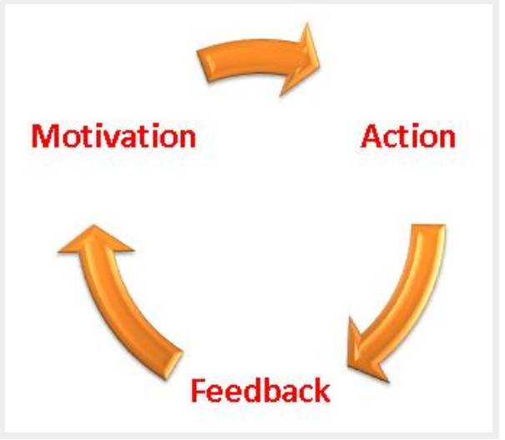
Solution Overview (Gamification Activity Loop)

Slide 21
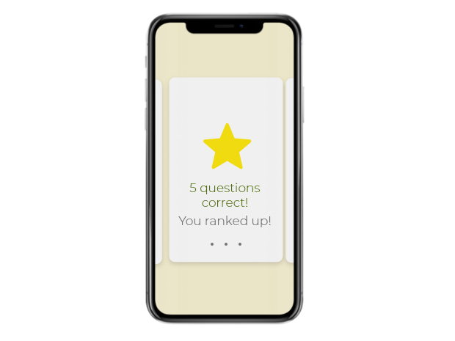
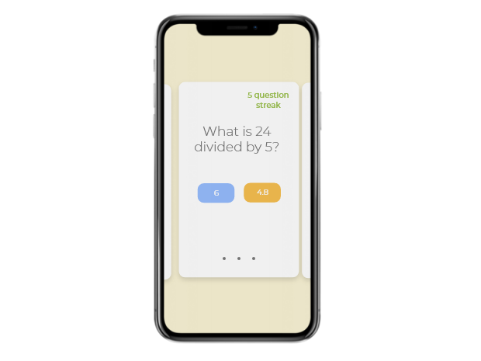
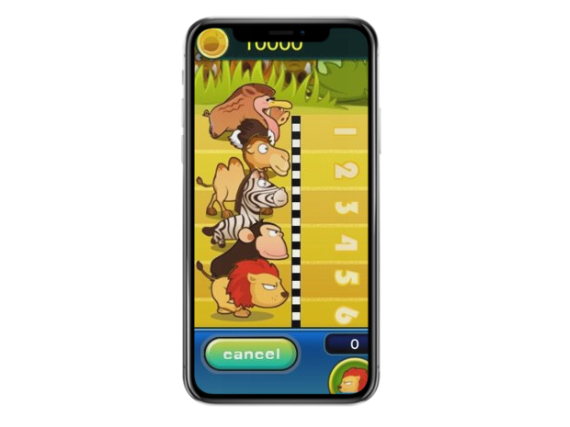
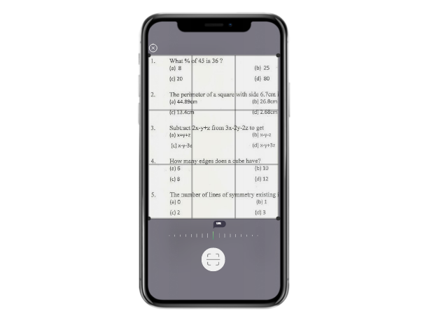
Solution Overview
Create quizzes by scanning homework
2. Interactive quiz with visual and audio cues
3. Gamified elements like scoreboard and progression

Slide 22
Appendix (References)
Reference http://theconversation.com/how-games-can-hook-students-with-short-attention-spans-56157 https://gamification21.wordpress.com/learning-content-4/24-activity-loops/
https://gamification21.wordpress.com/learning-content-4/24-activity-loops/
Interview Script https://docs.google.com/document/d/1wu-uFQ_ondf2Y1hAyweKORpmnI7tDOi-NeQYJPdYUiA/edit
Notes:
Survey: good to get a good grasp of things, but at a very shallow level
Interview:

